Slide 1
Lungs Cancer Classification Using Convolution Neural Network
Presented by :
Tayyba Salamat_032
Sana Akbar_026
Ubaida Waheed_034

Slide 2
Literature Review
Several studies have reported the use of CNNs for lung cancer type classification. One study used a CNN model trained on a dataset of computed tomography (CT) scans to classify lung cancer into three subtypes: adenocarcinoma, squamous cell carcinoma, and large cell carcinoma.
The model achieved an accuracy of 96.6%, which is a significant improvement over traditional methods such as radiologists' diagnoses.
There are pre-trained models available like ChexNet, which is a 121-layer CNN trained on chest radiographs and has been shown to perform well in detecting lung pathology.

Slide 3
INTRO TO OUR PROJECT
We have made a LUNGS CANCER CLASSIFIER
It classifies Lungs scan into three classes
Benign Case
Malignant Case
Normal Case
At back-end we have implemented CNN to train our model by tuning hyper-parameters like dropout, Adam optimizer using RELU and Softmax Activation Function.
We have developed a front-end web interface of our project using Flask.

Slide 4
ABOUT DATASET
The Dataset we have used is collected by Iraq-Oncology Teaching Hospital/National Center for Cancer Diseases (IQ-OTH/NCCD) lung cancer specialist of three months in fall 2019.
It includes CT scans of patients diagnosed with lung cancer in different stages, as well as healthy subjects.
The dataset contains a total of 1097 images representing CT scans of 3 classes.
Each scan contains several slices. The number of these slices range from 80 to 200 slices, each of them represents an image of the human chest with different sides and angles.
The 110 cases vary in gender, age, educational attainment, area of residence and living status.

Slide 5
ABOUT MODEL
A CNN model is trained using this data and the architecture of the model is optimized using techniques that best fitted to our model such as
Dropout
Adam optimizer
using RELU and Softmax Activation Function.
The first preprocessing of the dataset is done by
Rescaling (/255)
Resizing (256x256)
Then model is spliced into the train and validate split which is 80%, 20%.
Test data was separated from the main dataset initially into separate .csv file containing 20 images from each three classes.
Our CNN model consists of six convolution layers of 32, 64,64,64,128,128 filters respectively and max pooling of (2,2).
One fully connected layer (64 nodes).
Activation Function : RELU
Output Layer : SOFTMAX

Slide 6
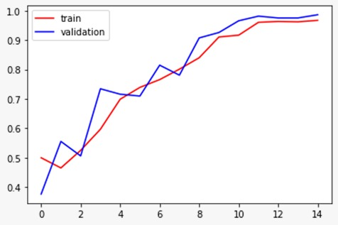
ACCURACY

Slide 7
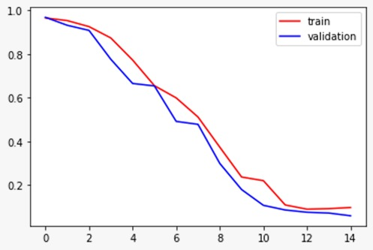
LOSS

Slide 8
About Front End
For Front-end we have developed a Web interface using Flask which is a Python library for creating interactive web applications.
Our Web application allows to upload an image of lung scan and receive a prediction on whether the case is malignant, benign or normal.
Trained model is integrated with front-end.
Input image is first pre-processed before being given to the trained model.
Pre-processed Image is then sent back to the train model which sends back it’s prediction out of three classes which is then printed on screen.

Slide 9
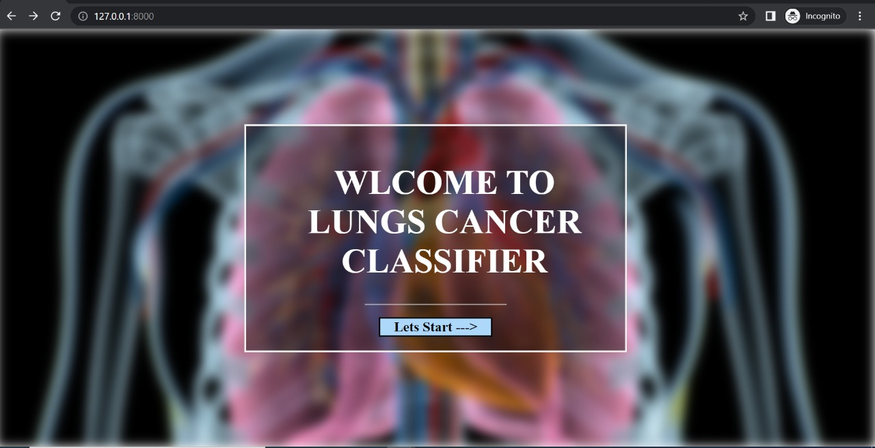
FRONT-END

Slide 10
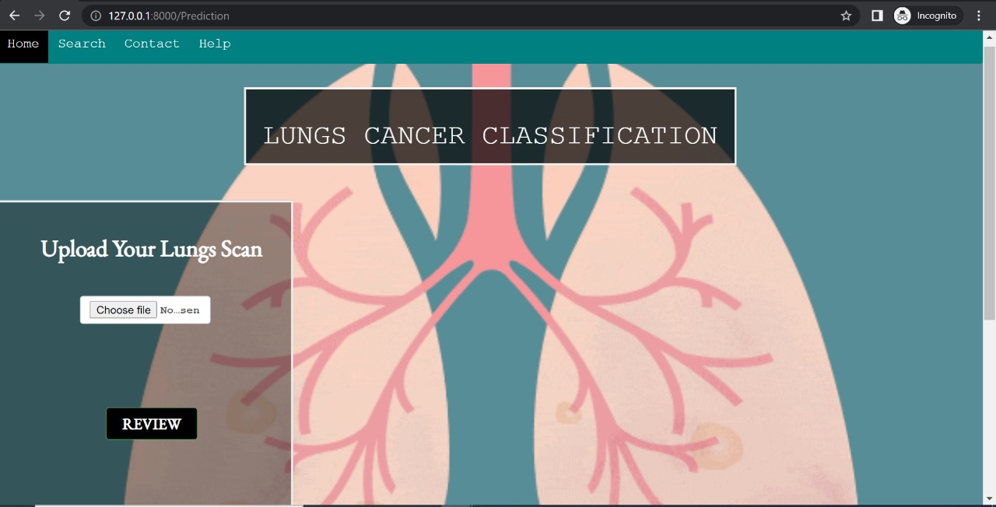

Slide 11
